Slide 1
Transformers - IV
Lecture 8
Part 4
Generative AI for Computer Vision

Slide 2
Content
Transformer Encoder
  Self Attention
  Multi-head Attention
  Layer Normalization
  Feed-forward Neural Network
Transformer Decoder
Different Types of Transformers

Slide 3
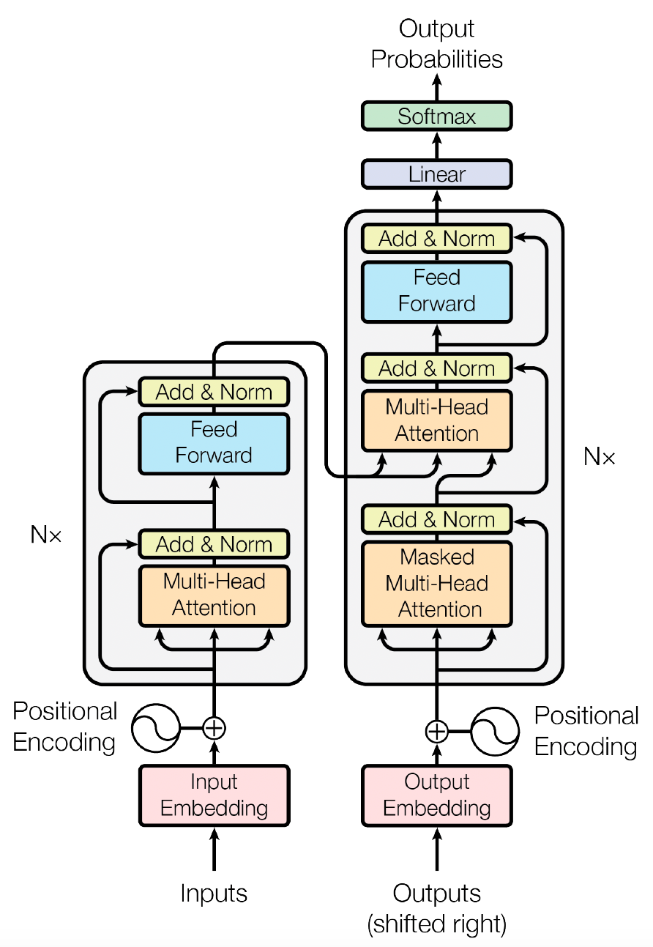
Full Encoder at a glance
Multi-head Attention
Multi-head Attention
Positional Encoding
Is
MULTI-HEAD ATTENTION
mac
léinn
mé
Word Embedding
Input to encoder
Figure Source: Ashish Vaswani et. al. Attention is All You Need, NIPS 2017

Slide 4





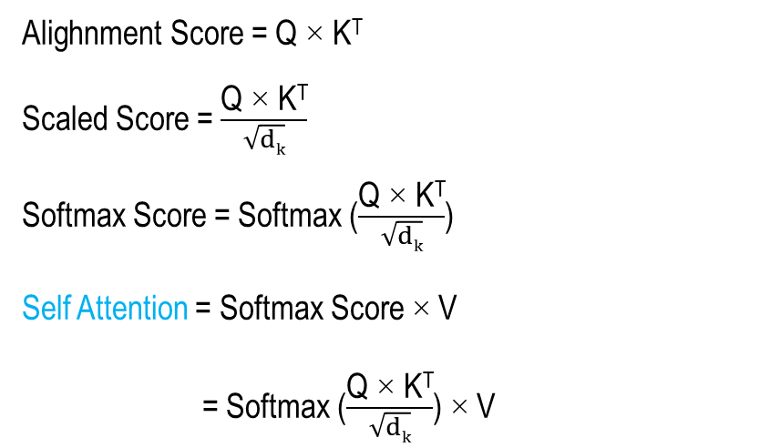










Self Attention
Positional Encoding
W^{Q}
$$q_{1}$$
$$q_{2}$$
$$q_{3}$$
$$q_{4}$$
Q= [$q_{1} q_{2} q_{3} q_{4}]$
Is
q_{i} = X_{i} × W^{Q}
(1 × 4) (1 × 4) × (4 × 4)
mac
W^{V}
Query vectors
$$v_{1}$$
$$v_{2}$$
$$v_{3}$$
$$v_{4}$$
V= [$v_{1} v_{2} v_{3} v_{4}]$
v_{i} = X_{i} × W^{V}
(1 × 4) (1 × 4) × (4 × 3)
léinn
W^{K}
Value vectors
$$k_{1}$$
$$k_{2}$$
$$k_{3}$$
$$k_{4}$$
Alighnment Score = Q × K^{T}
Scaled Score = $\frac{\text{Q} \text{×} \text{K}\text{T}}{\sqrt{dk}}$
Softmax Score = Softmax ($\frac{\text{Q} \text{×} \text{K}\text{T}}{\sqrt{dk}}$)
Self Attention = Softmax Score × V
= Softmax ($\frac{\text{Q} \text{×} \text{K}\text{T}}{\sqrt{dk}}$) × V
K= [$k_{1} k_{2} k_{3} k_{4}]$
k_{i} = X_{i} × W^{K}
(1 × 4) (1 × 4) × (4 × 4)
mé
Key vectors
Word Embedding
Input to encoder
[1x4]
4x4 (let)
Figure Source: Ashish Vaswani et. al. Attention is All You Need, NIPS 2017

Slide 5
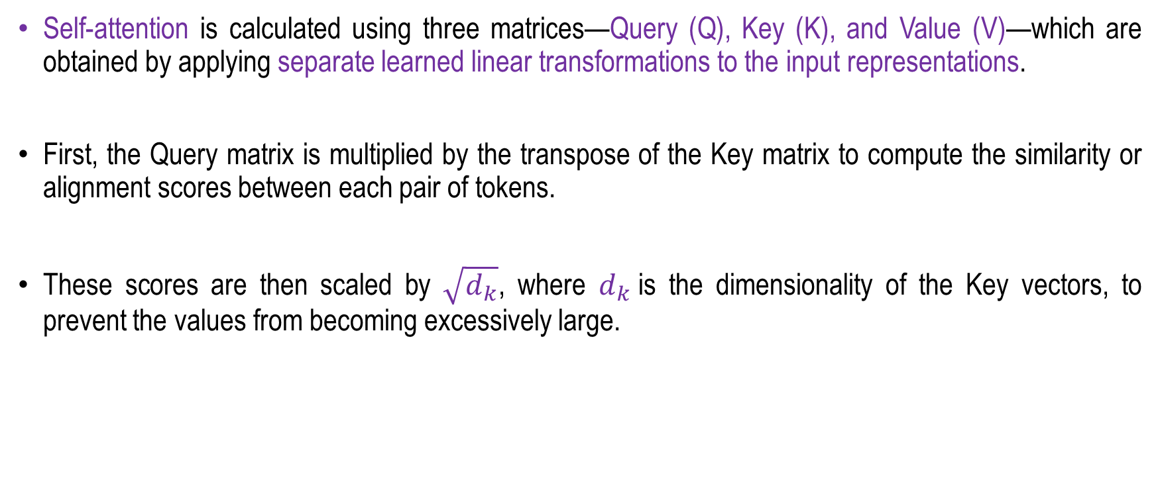
Self Attention
Self-attention is calculated using three matrices—Query (Q), Key (K), and Value (V)—which are obtained by applying separate learned linear transformations to the input representations.
First, the Query matrix is multiplied by the transpose of the Key matrix to compute the similarity or alignment scores between each pair of tokens.
These scores are then scaled by $\sqrt{d_{k}}$, where $d_{k}$is the dimensionality of the Key vectors, to prevent the values from becoming excessively large.

Slide 6
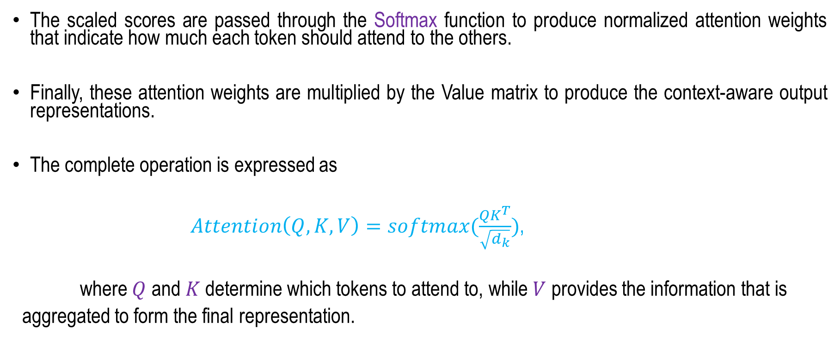
Self Attention
The scaled scores are passed through the Softmax function to produce normalized attention weights that indicate how much each token should attend to the others.
Finally, these attention weights are multiplied by the Value matrix to produce the context-aware output representations.
The complete operation is expressed as
$Attention\left(Q,K,V\right)=softmax(\frac{QK^{T}}{\sqrt{d_{k}}})$,
where $Q$ and $K$ determine which tokens to attend to, while $V$ provides the information that is
aggregated to form the final representation.

Slide 7
Multi-head Attention
Split into different heads
Q 1
Self
Attention
(6x512)
(512 X 512)
(6x512)
Head 1
*
Q 2
Q
W^{Q}
Q’
6x (128 128 128 128)
Q 3
Q 4
Self
Attention
Head 2
(6x512)
(512 X 512)
(6x512)
K 1
Input
(6x512)
*
K 1
Concatenation
K
W^{K}
K’
6x (128 128 128 128)
K 3
K 4
Self
Attention
Head 3
(6x512)
(512 X 512)
(6x512)
V 1
*
V 2
V
W^{V}
V’
6x (128 128 128 128)
Self
Attention
V 3
Head 4
V 4
For clarity, in this example,
We assume a different dimensions:
Input: 6 words
Input Dimension: [6x512]
W^{Q},W^{V},W^{K} =[512x512]
No. of Heads = 4
Q_{i},K_{i},V_{i} = [6x128]

Slide 8
Multi-head Attention
Multi-Head Attention is a core component of the Transformer architecture that enables the model to attend to different parts of a sequence simultaneously and capture multiple types of relationships among tokens.
Instead of performing a single attention operation, the input representations are projected into multiple sets of Query (Q), Key (K), and Value (V) matrices, with each set corresponding to a separate attention head.
Each head independently computes scaled dot-product attention, allowing it to focus on different aspects of the input, such as syntactic, semantic, or positional relationships.
The outputs from all attention heads are then concatenated and passed through a final learned linear transformation to produce the multi-head attention output.
By learning multiple attention patterns in parallel, Multi-Head Attention increases the expressive power of the Transformer and enables it to capture complex dependencies within the input sequence more effectively.

Slide 9
Multi-head Attention
Consider the sentence:
“The cat sat on the mat because it was tired.”
For example:
  Head 1: focuses on grammatical relationships, such as “it” → “cat.”
  Head 2: focuses on positional relationships, such as nearby words.
  Head 3: focuses on semantic relationships, such as “tired” being related to “cat.”
  Head 4: may focus on relationships between verbs and their subjects.

Slide 10
Encoder Architecture
Positional Encoding
Is
MULTI-HEAD ATTENTION
LAYER NORMALIZATION
mac
léinn
mé
Word Embedding
Input to encoder
Add & Normalization
Figure Source: Ashish Vaswani et. al. Attention is All You Need, NIPS 2017

Slide 11
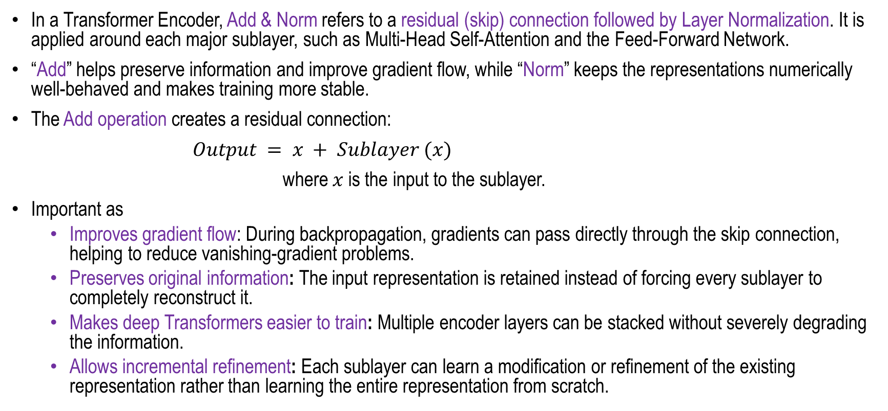
Why ADD (SKIP Connection) is required?
In a Transformer Encoder, Add & Norm refers to a residual (skip) connection followed by Layer Normalization. It is applied around each major sublayer, such as Multi-Head Self-Attention and the Feed-Forward Network.
“Add” helps preserve information and improve gradient flow, while “Norm” keeps the representations numerically well-behaved and makes training more stable.
The Add operation creates a residual connection:
$Output = x + Sublayer (x)$
where $x$ is the input to the sublayer.
Important as
  Improves gradient flow: During backpropagation, gradients can pass directly through the skip connection, helping to reduce vanishing-gradient problems.
  Preserves original information: The input representation is retained instead of forcing every sublayer to completely reconstruct it.
  Makes deep Transformers easier to train: Multiple encoder layers can be stacked without severely degrading the information.
  Allows incremental refinement: Each sublayer can learn a modification or refinement of the existing representation rather than learning the entire representation from scratch.

Slide 12
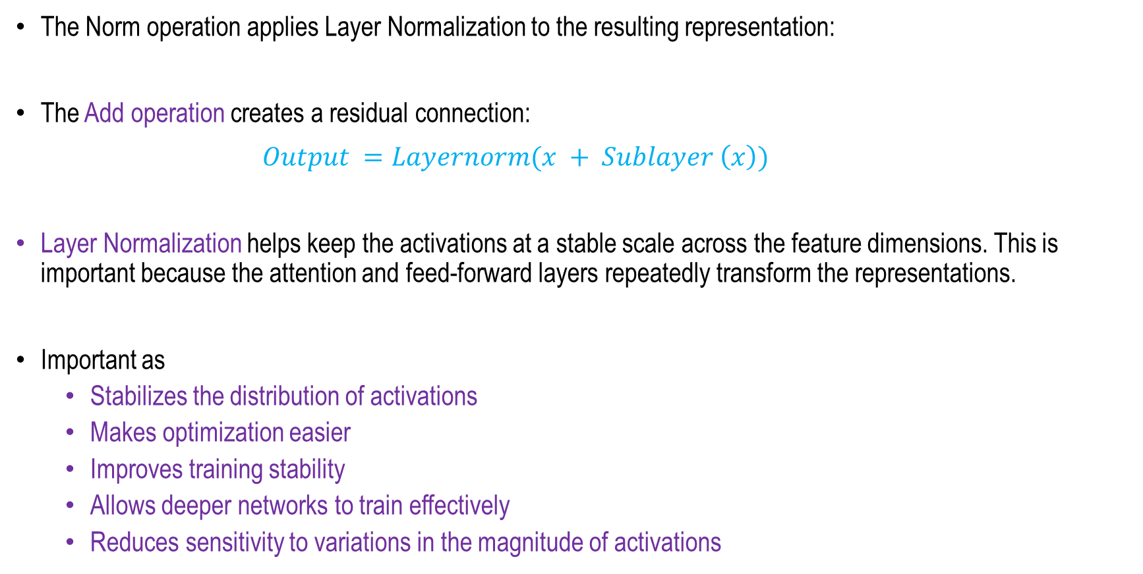
Why Norm is required?
The Norm operation applies Layer Normalization to the resulting representation:
The Add operation creates a residual connection:
$Output =Layernorm(x + Sublayer \left(x\right))$
Layer Normalization helps keep the activations at a stable scale across the feature dimensions. This is important because the attention and feed-forward layers repeatedly transform the representations.
Important as
  Stabilizes the distribution of activations
  Makes optimization easier
  Improves training stability
  Allows deeper networks to train effectively
  Reduces sensitivity to variations in the magnitude of activations

Slide 13
Encoder Architecture
Feed-forward Neural Network
Feed Forward Neural Network
Positional Encoding
Is
MULTI-HEAD ATTENTION
LAYER NORMALIZATION
FEED FORWARD NEURAL NETWORK
mac
léinn
mé
Word Embedding
Input to encoder
Add & Normalization
Figure Source: Ashish Vaswani et. al. Attention is All You Need, NIPS 2017

Slide 14
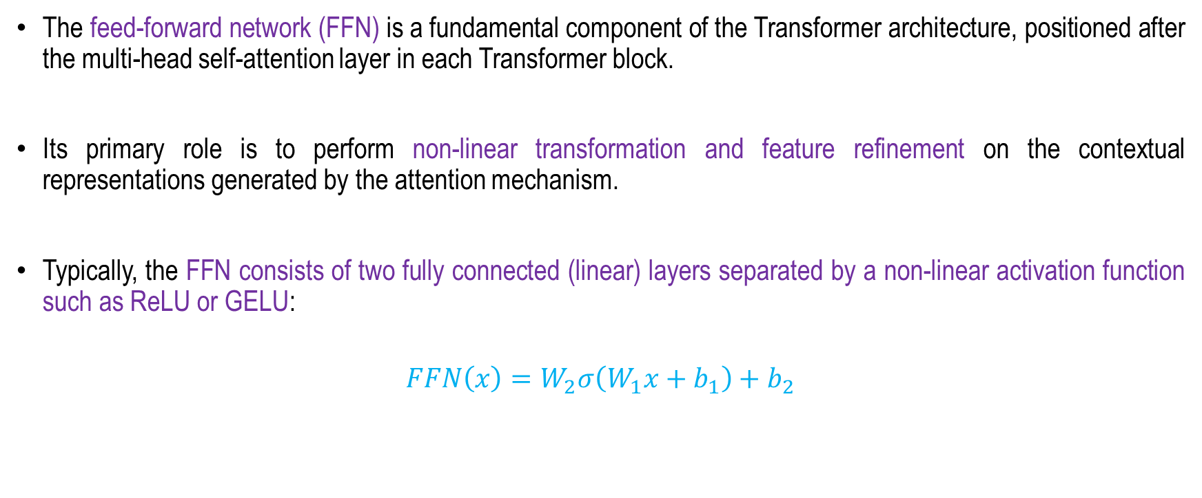
Feed-forward Neural Network
The feed-forward network (FFN) is a fundamental component of the Transformer architecture, positioned after the multi-head self-attention layer in each Transformer block.
Its primary role is to perform non-linear transformation and feature refinement on the contextual representations generated by the attention mechanism.
Typically, the FFN consists of two fully connected (linear) layers separated by a non-linear activation function such as ReLU or GELU:
$$FFN\left(x\right)=W_{2}σ\left(W_{1}x+b_{1}\right)+b_{2}$$

Slide 15
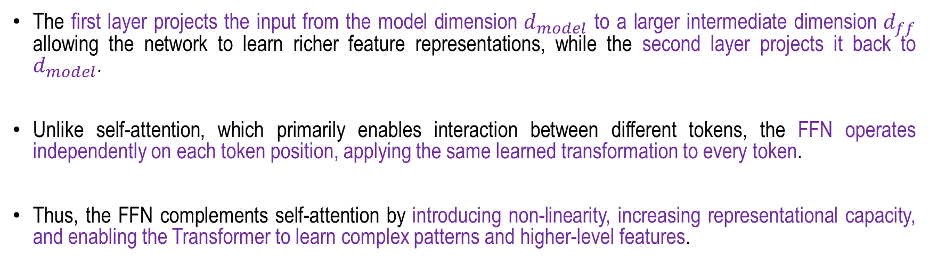
Feed-forward Neural Network
The first layer projects the input from the model dimension $d_{model}$ to a larger intermediate dimension $d_{ff}$ allowing the network to learn richer feature representations, while the second layer projects it back to $d_{model}$.
Unlike self-attention, which primarily enables interaction between different tokens, the FFN operates independently on each token position, applying the same learned transformation to every token.
Thus, the FFN complements self-attention by introducing non-linearity, increasing representational capacity, and enabling the Transformer to learn complex patterns and higher-level features.

Slide 16
Encoder Architecture
Feed-forward Neural Network
Feed Forward Neural Network
Positional Encoding
Is
MULTI-HEAD ATTENTION
LAYER NORMALIZATION
FEED FORWARD NEURAL NETWORK
mac
léinn
mé
Word Embedding
Input to encoder
Add & Normalization
Add & Normalization
Figure Source: Ashish Vaswani et. al. Attention is All You Need, NIPS 2017

Slide 17
Full Encoder at a glance
Positional Encoding
Is
MULTI-HEAD ATTENTION
LAYER NORMALIZATION
FEED FORWARD NEURAL NETWORK
mac
To next encoder layer
léinn
mé
Word Embedding
Input to encoder
Add & Normalization
Add & Normalization
Figure Source: Ashish Vaswani et. al. Attention is All You Need, NIPS 2017

Slide 18
Transformer Decoder
A Transformer decoder block receives two primary inputs: a sequence of input vectors x from the preceding decoder layer and a set of context vectors c produced by the encoder.
It generates a sequence of output vectors y, which are subsequently used to predict the next tokens in the target sequence.
The first sublayer is masked multi-head self-attention, in which each position is allowed to attend only to preceding positions and is prevented from accessing future tokens.
This causal masking preserves the autoregressive nature of the decoder and ensures that token generation depends only on previously available information.

Slide 19













Transformer Decoder
$$C_{1}$$
$$C_{2}$$
…
$$C_{n}$$
$$y_{0}$$
$$y_{0}$$
I
<start>
$$y_{1}$$
Decoder 1
Decoder 2
Decoder N
$$y_{1}$$
am
I
am
$$y_{2}$$
… …
$$y_{2}$$
a
a
$$y_{3}$$
$$y_{3}$$
student
student
$$y_{4}$$
$$y_{4}$$
<end>
Figure Source: Ashish Vaswani et. al. Attention is All You Need, NIPS 2017

Slide 20
Transformer Decoder
The resulting representations are then passed to a multi-head cross-attention sublayer, which differs from self-attention because its queries originate from the decoder, while the encoder context vectors c provide the keys and values.
This enables the decoder to selectively attend to relevant information from the encoded input sequence when generating each target token.
Finally, the attended representations are processed by a position-wise feed-forward network to produce the output representations of the decoder block.
Through this combination of masked self-attention, cross-attention, and feed-forward processing, the Transformer decoder can effectively model long-range dependencies while supporting highly parallelizable and scalable computation during training.
However, the quadratic computational and memory complexity of attention with respect to sequence length can result in substantial memory requirements for long input sequences.

Slide 21


























Transformer Decoder
$$C_{1}$$
$$C_{2}$$
…
$$C_{n}$$
$$y_{0}$$
$$y_{0}$$
I
<start>
$$y_{1}$$
Decoder 1
Decoder 2
Decoder N
$$y_{1}$$
am
I
am
$$y_{2}$$
… …
$$y_{2}$$
a
a
$$y_{3}$$
$$y_{3}$$
student
student
$$y_{4}$$
$$y_{4}$$
<end>
$$C_{1}$$
$$C_{2}$$
…
$$C_{n}$$
$$x_{0}$$
$$y_{0}$$
$$x_{1}$$
$$y_{1}$$
$$x_{2}$$
Positional
Encoding
Masked
Multi-head
Self Attention
Layer
Normalization
Multi-head Attention
k v q
Layer
Normalization
Layer
Normalization
$$y_{2}$$
MLP
FC
$$x_{3}$$
$$y_{3}$$
$$x_{4}$$
$$y_{4}$$
Concept: Fei-Fei Li Attention and Transformers CS231n Stanford Lecture

Slide 22
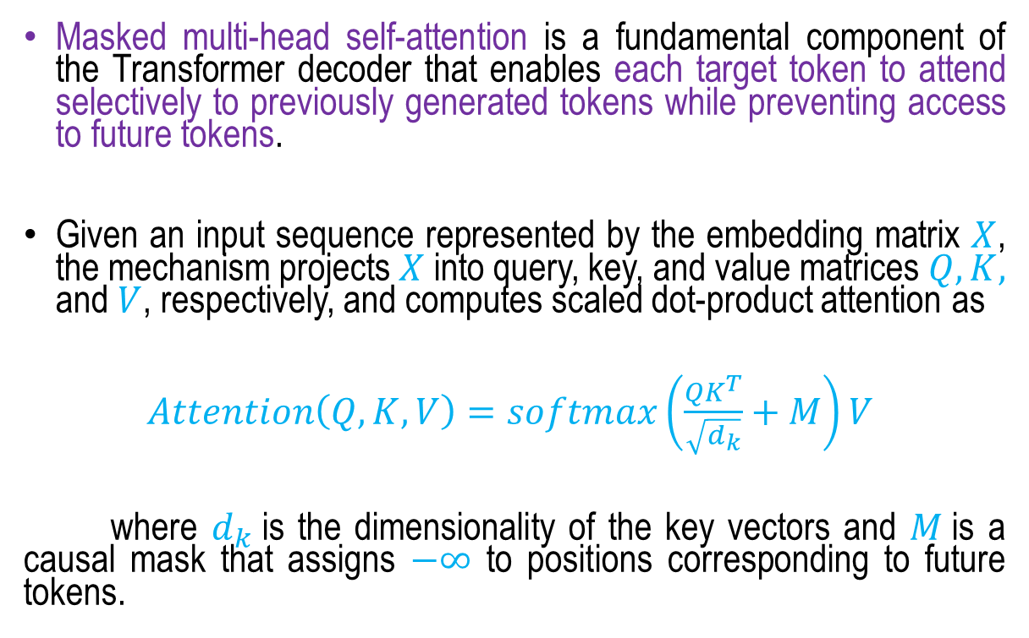
Masked multi-head self-attention
Masked multi-head self-attention is a fundamental component of the Transformer decoder that enables each target token to attend selectively to previously generated tokens while preventing access to future tokens.
Given an input sequence represented by the embedding matrix $X$, the mechanism projects $X$ into query, key, and value matrices $Q, K,$ and $V$, respectively, and computes scaled dot-product attention as
$Attention\left(Q,K,V\right)=softmax\left(\frac{QK^{T}}{\sqrt{d_{k}}}+M\right)V$
where $d_{k}$is the dimensionality of the key vectors and $M$is a causal mask that assigns $−∞$ to positions corresponding to future tokens.
Figure Source: Ashish Vaswani et. al. Attention is All You Need, NIPS 2017

Slide 23
Masked multi-head self-attention
The masking operation ensures the decoder maintains the autoregressive property, generating each token solely from the previously observed context.
Multi-head attention performs this operation across multiple independently learned projection spaces, allowing the model to capture different types of dependencies and contextual relationships simultaneously.
The outputs of all attention heads are concatenated and passed through a learned linear projection, providing a rich contextual representation that is subsequently processed by the decoder's feed-forward network.

Slide 24
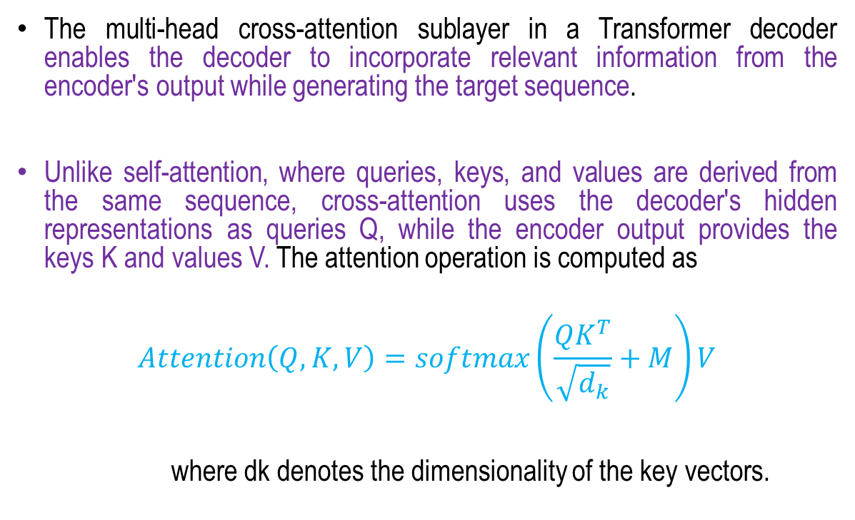
Multi-head cross-attention sublayer
The multi-head cross-attention sublayer in a Transformer decoder enables the decoder to incorporate relevant information from the encoder's output while generating the target sequence.
Unlike self-attention, where queries, keys, and values are derived from the same sequence, cross-attention uses the decoder's hidden representations as queries Q, while the encoder output provides the keys K and values V. The attention operation is computed as
$$Attention\left(Q,K,V\right)=softmax\left(\frac{QK^{T}}{\sqrt{d_{k}}}+M\right)V$$
where dk denotes the dimensionality of the key vectors.
Figure Source: Ashish Vaswani et. al. Attention is All You Need, NIPS 2017

Slide 25
Multi-head cross-attention sublayer
The resulting attention weights determine the extent to which each decoder position focuses on different positions in the encoded input sequence, allowing the decoder to identify and utilize the most relevant source information for predicting each target token.
In multi-head cross-attention, this process is performed simultaneously across multiple attention heads using independent learned projections.
Each head can capture different relationships between the source and target sequences, and their outputs are concatenated and transformed through a final linear projection.
The cross-attention output is typically combined with the decoder's previous representation through a residual connection and subsequently normalized, enabling effective information flow and stable optimization within the decoder architecture.

Slide 26
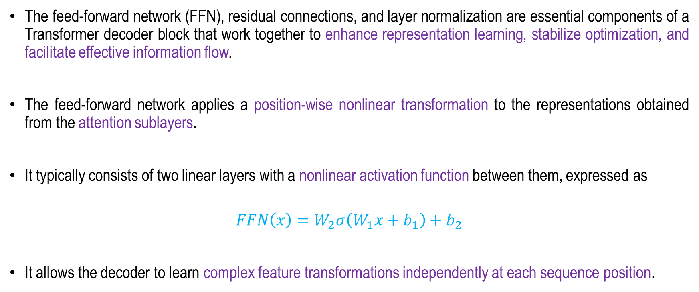
The feed-forward network (FFN), residual connections, and layer normalization
The feed-forward network (FFN), residual connections, and layer normalization are essential components of a Transformer decoder block that work together to enhance representation learning, stabilize optimization, and facilitate effective information flow.
The feed-forward network applies a position-wise nonlinear transformation to the representations obtained from the attention sublayers.
It typically consists of two linear layers with a nonlinear activation function between them, expressed as
$$FFN\left(x\right)=W_{2}σ\left(W_{1}x+b_{1}\right)+b_{2}$$
It allows the decoder to learn complex feature transformations independently at each sequence position.

Slide 27
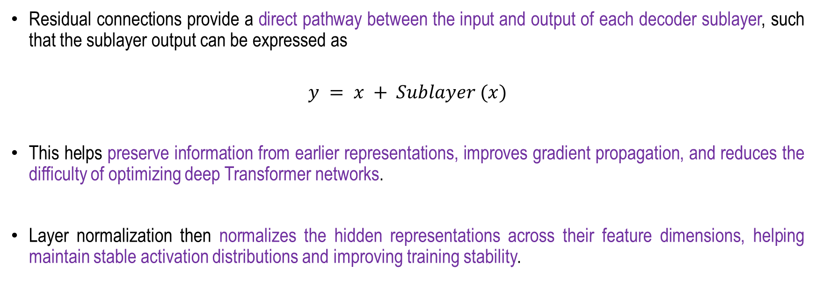
The feed-forward network (FFN), residual connections, and layer normalization
Residual connections provide a direct pathway between the input and output of each decoder sublayer, such that the sublayer output can be expressed as
$$y = x + Sublayer (x)$$
This helps preserve information from earlier representations, improves gradient propagation, and reduces the difficulty of optimizing deep Transformer networks.
Layer normalization then normalizes the hidden representations across their feature dimensions, helping maintain stable activation distributions and improving training stability.

Slide 28
The feed-forward network (FFN), residual connections, and layer normalization
In a decoder block, these components are applied around the masked self-attention, cross-attention, and feed-forward sublayers, enabling the network to progressively refine contextual representations while maintaining efficient information propagation.
Together, the FFN provides nonlinear feature transformation, residual connections support information and gradient flow, and layer normalization promotes stable and efficient optimization, thereby contributing to the overall effectiveness and scalability of the Transformer decoder.

Slide 29
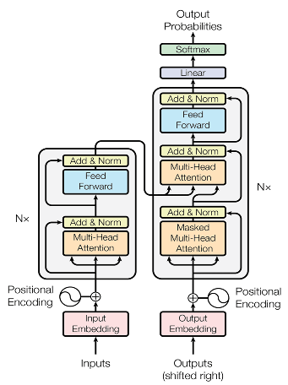
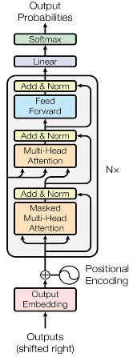
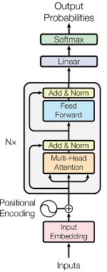
Transformer
The original Transformer model is an encoder-decoder architecture that serves translation tasks well.
Transformer based models
  Encoder-only model
  Encoder-Decoder model
  Decoder-only model
Encoder-Only (BERT*)
Encoder-Decoder (Transformer)
Decoder-Only (GPT*)
*Conceptual diagram. Exact models may be slightly different
Figure: https://towardsdatascience.com/a-complete-guide-to-bert-with-code-9f87602e4a11/

Slide 30
Summary
Transformer Encoder
  Self Attention
  Multi-head Attention
  Layer Normalization
  Feed-forward Neural Network
Transformer Decoder
Different Types of Transformers

Slide 31
Vision Transformers
Next
Lecture 9: Part 1
Generative AI for Computer Vision

